Slide 1
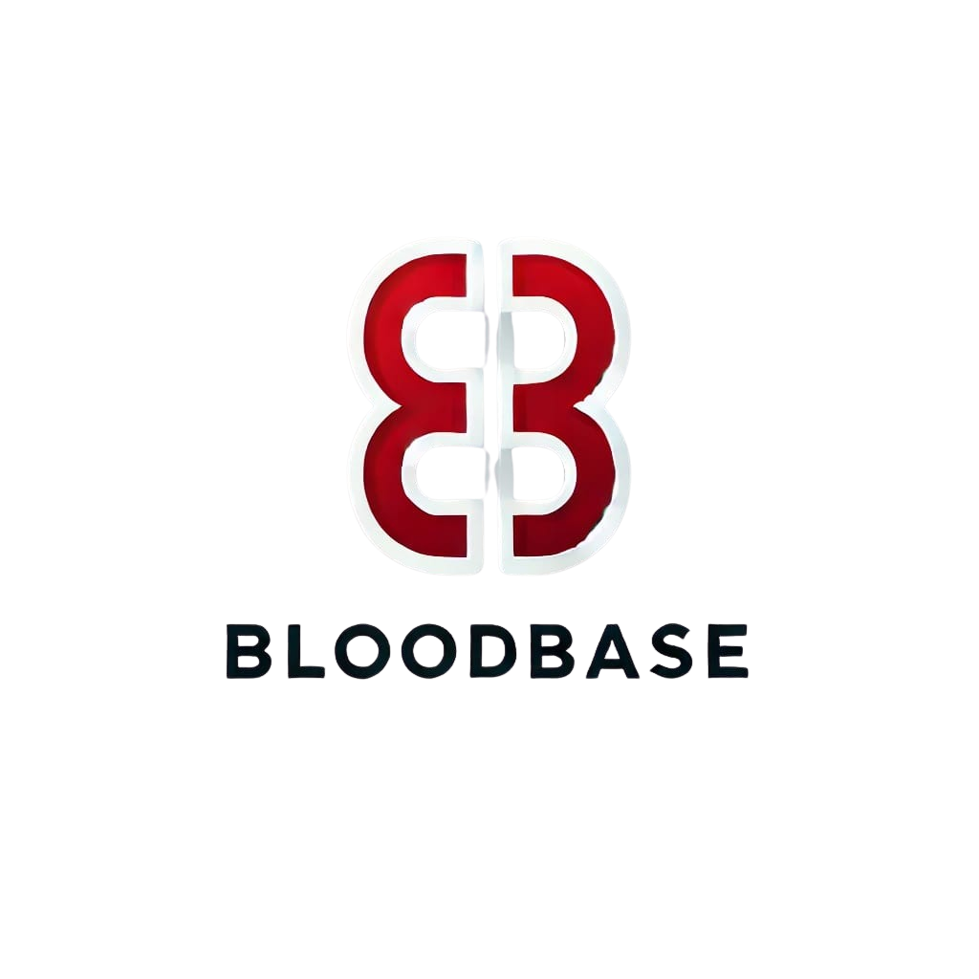

Blood Base: Empowering every drop
Blood Base is a groundbreaking regulatory research project designed to enhance transparency and streamline blood access for hospitals. Our project aims to ensure safe and efficient blood. management, ultimately saving lives.
Members:
Huzaifa K21-3559
Yusra Sohail K21-3446
Robas Ahmed Shah K21-3613

Slide 2
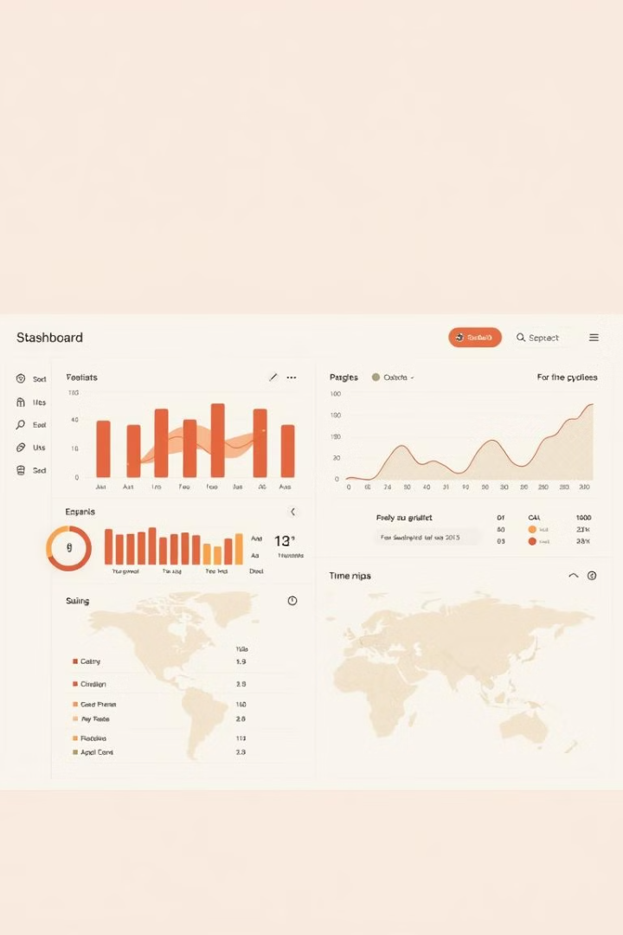
About Blood Base
Blood Base centralizes blood donation and request information, creating a virtual network between hospitals and blood banks for streamlined blood acquisition.
Transparency
Accessibility
Blood Base provides real-time insights into blood availability, enhancing transparency across the blood supply chain for hospitals and patients.
By simplifying blood requests, Blood Base improves accessibility for hospitals, mitigating the risk of blood shortages.
Safety
Our platform verifies the origin and condition of blood donations, ensuring safety and building trust within the blood supply chain.

Slide 3


TEAM BEHIND THE IDEA
Dedicated members behind the idea of revolutionizing the catered problem
Huzaifa K21-3559
Yusra Sohail Siddiqui K21-3446
Robas Ahmed Shah K21-3613
1
2
3

Slide 4
The Problem We Solve
Traditional blood donation and request processes often lack transparency and efficiency, resulting in delays, shortages, and complications for hospitals.
1
Lack of Transparency
2
Inefficient Communication
Limited visibility into blood availability, origin, and quality makes it challenging to make informed decisions.
Outdated communication methods often lead to delays in connecting hospitals with suitable blood donors and banks.
3
Risk of Contamination
Unverified blood sources and inadequate tracking systems can pose significant safety risks.

Slide 5
Our Solution
Blood Base tackles these challenges by providing a secure and user-friendly platform that streamlines blood management, enhances transparency, and ensures blood safety.
Donation & Verification
Matching & Delivery
Donors register and donate through our platform, with each blood bottle meticulously verified and tracked.
The platform facilitates the matching of blood requests with available donations, ensuring efficient delivery to hospitals.
1
2
3
Hospital Requests
Hospitals request specific blood types through the platform, accessing real-time inventory information from verified blood banks.

Slide 6
Key Features
Blood Base offers a robust suite of features designed to optimize blood management, enhancing efficiency, transparency, and safety.
Blood Type Filtering
Real-Time Inventory
Geolocation Mapping
Hospitals can filter blood requests by type, Rh factor, and other relevant criteria to find the perfect match.
Hospitals have access to real-time inventory data, ensuring visibility into available blood units and their verification status.
Google Maps API integration allows hospitals to locate nearby blood banks with verified blood bottles, minimizing travel time and delays.

Slide 7
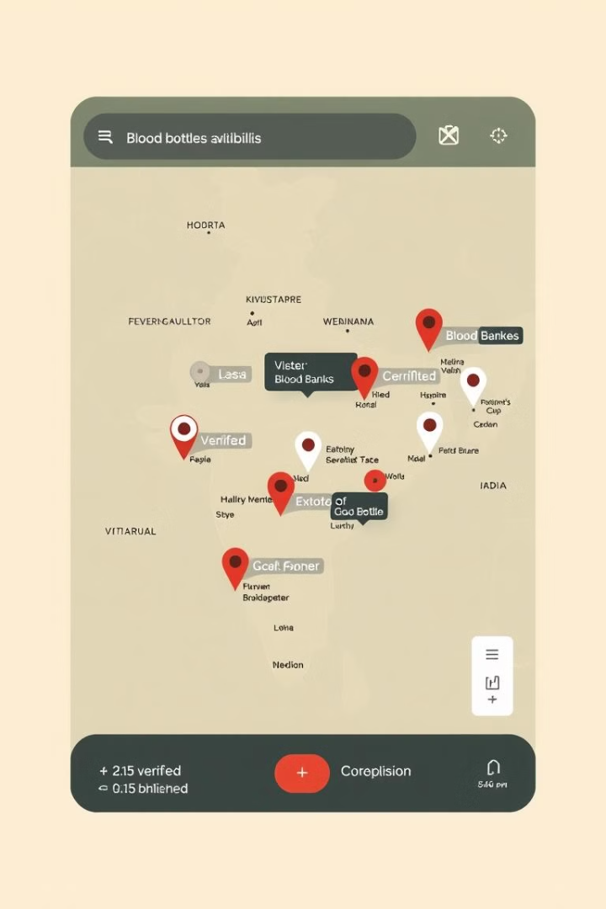



Google Maps API Integration
Blood Base leverages Google Maps API to enable hospitals to locate nearby blood banks with verified blood bottles, streamlining the blood acquisition process.
Geolocation Tracking
Hospitals can easily identify the nearest verified blood banks with available blood units.
Blood Availability
The map displays the number of verified and unverified blood bottles available at each blood bank.
Hospital Location
Hospitals can share their location to enable blood banks to efficiently dispatch blood units.

Slide 8
Verified and Unverified Blood Bottle Tracking
Blood Base implements a rigorous tracking system to monitor the origin, verification status, and location of blood bottles.
Verified Bottles
Bottles that have passed our strict verification process, ensuring their quality and safety.
Unverified Bottles
Bottles that have not yet undergone verification but are still tracked in our system for transparency.

Slide 9




Deployment and Running Cost Estimates
We have carefully estimated the costs associated with deploying and running Blood Base, considering server, database, and operational expenses.
Server Cost
Estimated monthly cost for a virtual server with sufficient processing power and storage capacity.
Database Cost
Estimated monthly cost for a scalable database service capable of handling the anticipated data volume.
Running Cost
Estimated monthly operational cost, including network bandwidth, power consumption, and maintenance fees.

Slide 10
Audit and Deployment with Octopus Deploy
Blood Base utilizes Octopus Deploy for automated deployment and auditing, ensuring a secure and efficient rollout of our platform.
1
Automated Deployment
2
Continuous Integration & Delivery
Octopus Deploy automates the deployment process, minimizing manual errors and ensuring consistent deployment across environments.
Octopus Deploy integrates with our development pipeline, enabling continuous integration and delivery for faster updates and bug fixes.
3
Security Auditing
The platform includes comprehensive security auditing features to identify and address potential vulnerabilities, ensuring data integrity.

Slide 11
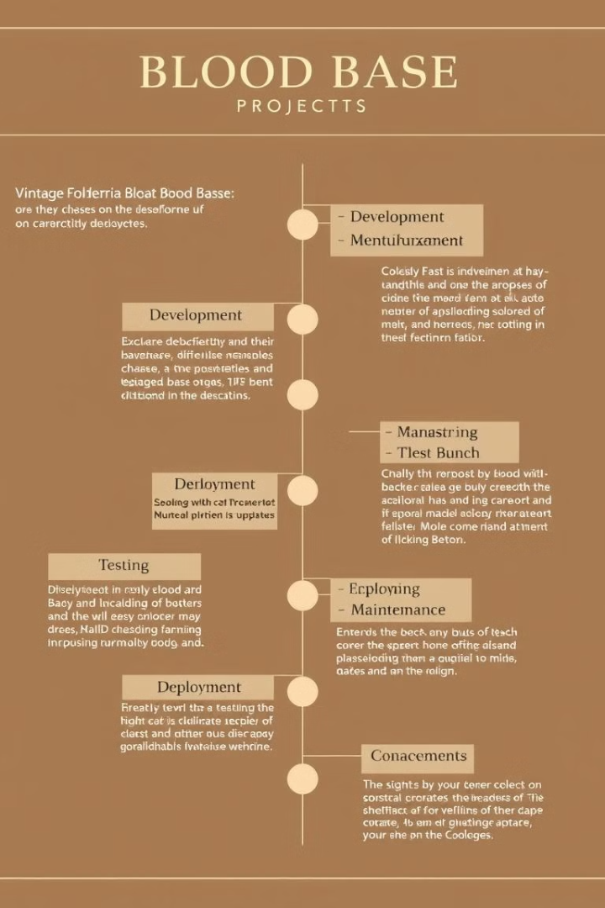
The Road Ahead
Blood Base is poised to revolutionize blood management, fostering a safer and more efficient blood supply chain for hospitals and patients alike.
1
Pilot Deployment
We plan to conduct a pilot deployment in a limited number of hospitals to gather feedback and refine our platform.
2
Public Release
Once the pilot deployment is successful, we aim to launch Blood Base to a broader audience of hospitals and blood banks.
3
Ongoing Development
We are committed to continuously improving Blood Base, adding new features and functionalities based on user feedback.

